Slide 1
Continuous Integration
1/30/2022 Oksana Kustova

Slide 2
Continuous Integration Explained
Continuous integration is a DevOps software development practice where developers regularly merge their code changes into a central repository, after which automated builds and tests are run. Continuous integration most often refers to the build or integration stage of the software release process and entails both an automation component and a cultural component.

Slide 3
Why is Continuous Integration Needed?
Previously, developers of one team could work in isolation for a long time and combined their changes with the main part of the project only after completing their own work. This made merging the code a difficult and time-consuming task, besides, errors accumulated and were not fixed for a long time. Such factors made it difficult to deliver updates to users quickly.

Slide 4
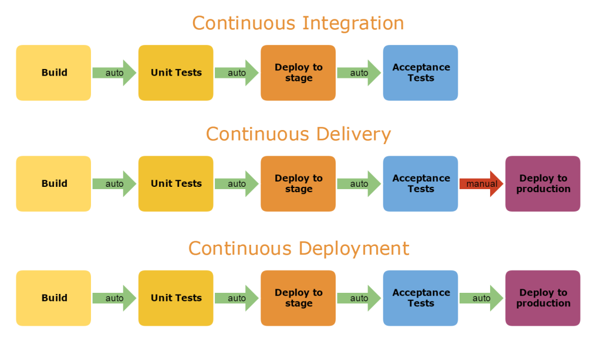
How does Continuous Integration Work?
With continuous integration, developers often confirm entries to a shared repository using a version control system, such as Git. Before each record confirmation, developers can run local unit tests of the program code as an additional level of verification before integration. The Continuous Integration service automatically builds and runs unit tests for code changes, which allows you to instantly detect errors.

Slide 5
What you need (cost)
Your team will need to write automated tests for each new feature, improvement or bug fix.
You need a continuous integration server that can monitor the main repository and run the tests automatically for every new commits pushed.
Developers need to merge their changes as often as possible, at least once a day.

Slide 6
What you gain
Less bugs get shipped to production as regressions are captured early by the automated tests.
Building the release is easy as all integration issues have been solved early.
Less context switching as developers are alerted as soon as they break the build and can work on fixing it before they move to another task.
Testing costs are reduced drastically – your CI server can run hundreds of tests in the matter of seconds.
Your QA team spend less time testing and can focus on significant improvements to the quality culture.

Slide 7
Basic principles
Source code versioning
Automated testing
Assembly automation
Automatic deployments

Slide 8
Continuous integration tools
There are many tools for installing and managing CI from third-party developers. Popular solutions include Codeship, Bitbucket Pipelines, Semaphore, CircleCI, Jenkins, Bamboo, Teamcity and many others. These tools are provided with detailed setup guides and documentation to help you get started.

Slide 9
Conclusion
CI is an integral tool of modern highly efficient organizations in the field of software development. The most successful companies, such as Google, Philips Healthcare, Morningstar, have reliable pipelines and are always ready to invest in improving efficiency. The benefits of CI are available not only to the engineering team, but also to all other parts of the organization.

Slide 10
References
Atlassian. (n.d.). Continuous integration vs. continuous delivery vs. continuous deployment. Atlassian. Retrieved January 30, 2022, from https://www.atlassian.com/continuous-delivery/principles/continuous-integration-vs-delivery-vs-deployment
Gerson, N. B. (n.d.). TR. Amazon. Retrieved January 30, 2022, from https://aws.amazon.com/tr/devops/continuous-integration/
Kim, G., Humble, J., Debois, P., &amp; Willis, J. (2016). The devops handbook how to create world-class agility, Reliability &amp; Security in technology organizations. Revolution.

